Slide 1
Technology Resources Improvement Plan

Slide 2
Purpose
A technology plan is not simply a plan for what technology should be purchased and when it should be upgraded.
It is a mechanism to help prioritize and budget for the technology tools that are most important for achieving organizational goals.

Slide 3
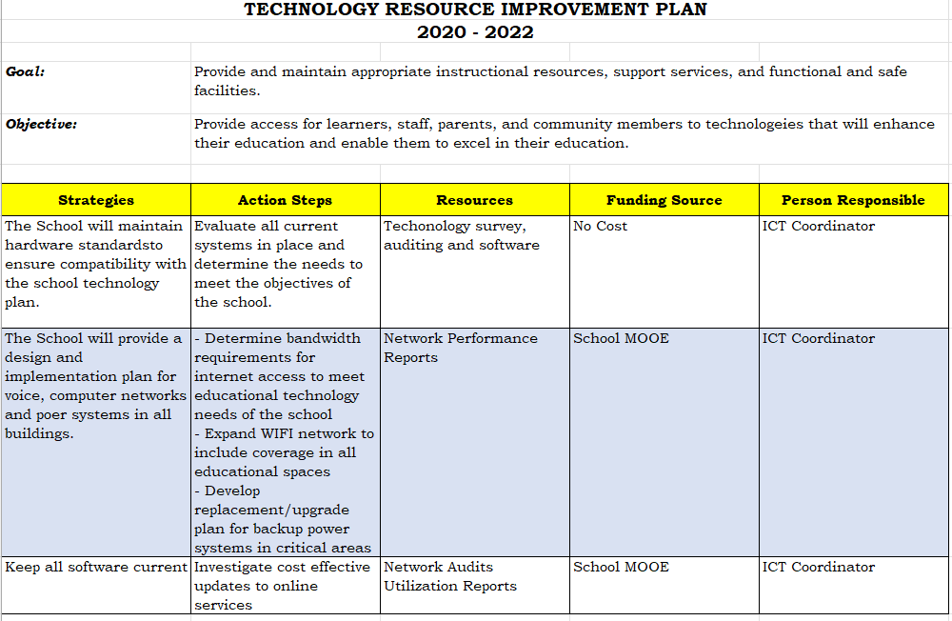

Slide 4
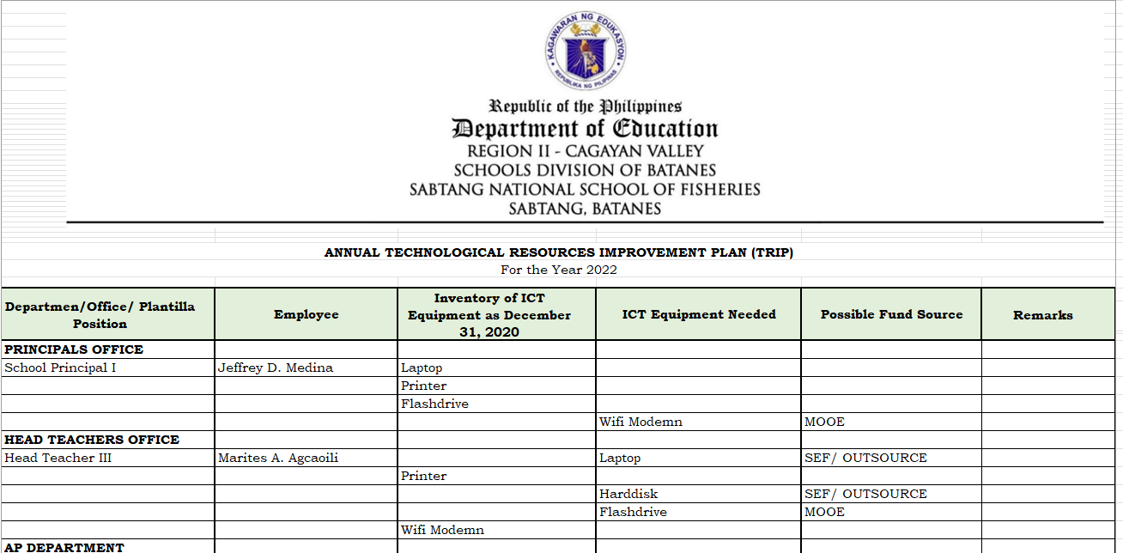

Slide 5
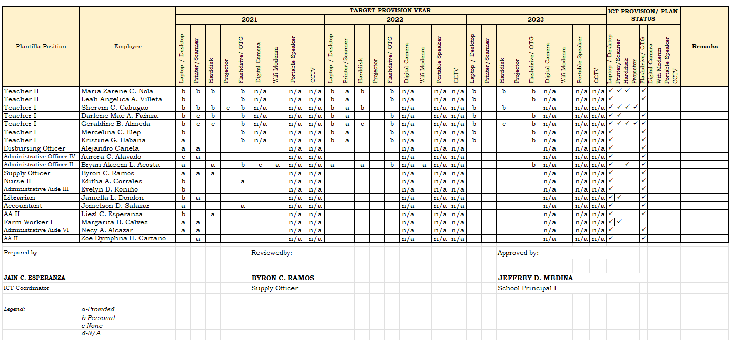

Slide 6
Communication Templates and Establishment of Committees in Schools

Slide 7
Legal Basis
DM 14, s. 2022 (DepED Quality Management System Manual and Procedures and Works Instructions Manual)
ISO 10013:2021: Quality Management System – Guidance for documented information
DepED Order 31, s. 2019 The Department of Education Service Marks and Visual Identity Manual
DepEd Order 30, s. 2019: The Department of Education Manual of Style

Slide 8
Different Types of Documented Information in the Department
DepED Order
DepED/Regional/Division/Schoool/Office Memorandum
Office Order
DepED Advisory
Forms and Templates
QMS Manual
PAWIM
Planning Documents
Operations Manual

Slide 9
DepED Documents
Office Order
  contains operational guidelines, rules, and procedures on matters of internal administration of DepEd's bureaus/services, centers, units, offices, or schools.
  It also includes notices of human resource actions or decisions.
  Its concerns are usually limited to the school.
  It is signed by the School Head
  Its application is usually short-term or temporary

Slide 10
DepED Documents
Office Memorandum
  disseminates instructions or information on officials, personnel, and staff of the school.
  Its concerns are usually limited the school.
  It is signed by the School Head.
  Its application is usually short-term or temporary.

Slide 11

School Memorandum
  similar to a DepEd Memorandum but is addressed to all personnel and/or stakeholders within the School.
  It is signed by the School Head.

Slide 12
DepED Memorandum
  provide the detailed procedures for implementing established aws or policies of DepEd or other government agencies. It is signed by the Secretary as it is department-wide in scope.
  DMs disseminates instructions, information, or related matters, including:
    a. creation of committees or task forces;
    b. submission of lists or reports;
    c. announcement of celebrations, surveys, holidays, examinations, contests, or results thereof;
    d. conference or seminars conducted by the bureaus, centers, services, units, and divisions; and
    e. reiteration of regulations or laws issued by other agencies and departments.

Slide 13
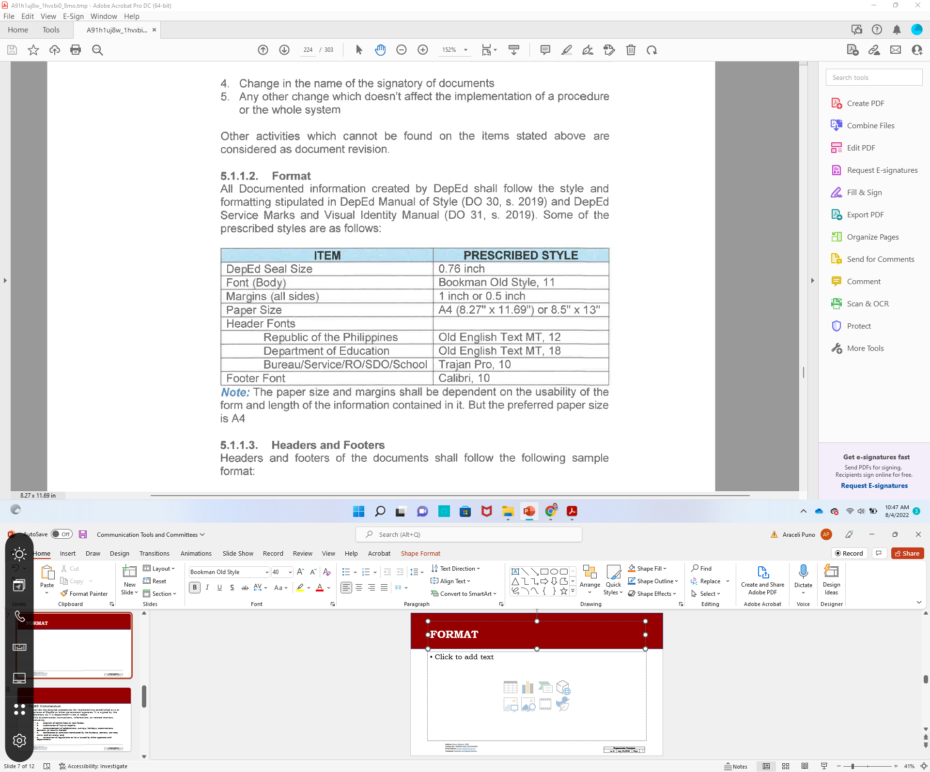
FORMAT

Slide 14
Templates can be downloaded here
http://depedbatanes.ph/projectclick.php
  Office Order
  Office Memorandum
  School Memorandum
  Attendance Sheets
  Minutes of Meetings

Slide 15
School Committees

Slide 16
School Committees/ Associations | Legal Basis | When to Organize
School Governing Council | RA 9155, SGC manual, DO 026, s. 2022 9Implementing Guidelines on the Establishment of School Governance Council) | Start of the School Year
School Planning Team | DepEd Order 44, s. 2015 (Guidelines on the Enhanced School Improvement Planning SIP) Process and the School Report Card (SRC) | Yearly (Fiscal Year)
Parent-Teacher’s Association | DepED Order No. 13, s. 2022 (Omnibus Guidelines on the Regulation of Operations of Parent-Teacher Associations) | Start of the School Year
Child Protection Committee | DO 40, s. 2012 9 (DepED Child Protection Policy), DO 55, s. 2013 (Implementing Rules and Regulations (IRR) of Republic Act (RA) No. 10627 Other wise Known as the Anti-Bullying Act of 2013 | Start of the School Year

Slide 17
School Committees/ Associations | Legal Basis | When to Organize
Supreme Students Council/Supreme Pupils Council | DO 47, s. 2014 (Constitution and By-Laws of the Supreme Pupil Government and Supreme Student Government in Elementary and Secondary Schools), DO 34, s. 2008 (Mandated Thrusts, programs and activities of the Supreme Student Government | Start of the School Year
Project Teams | DepEd Order 44, s. 2015 (Guidelines on the Enhanced School Improvement Planning 9SIP) Process and the School Report Card (SRC) | Yearly (Fiscal Year)
Project Monitoring Teams | DepEd Order 44, s. 2015 (Guidelines on the Enhanced School Improvement Planning 9SIP) Process and the School Report Card (SRC) | Yearly (Fiscal Year)
School-Faculty Association |  | Depends on the set schedule and by-laws

Slide 18
DO 26, s. 2022
Implementing Guidelines on the Establishment of School Governance Council

Slide 19
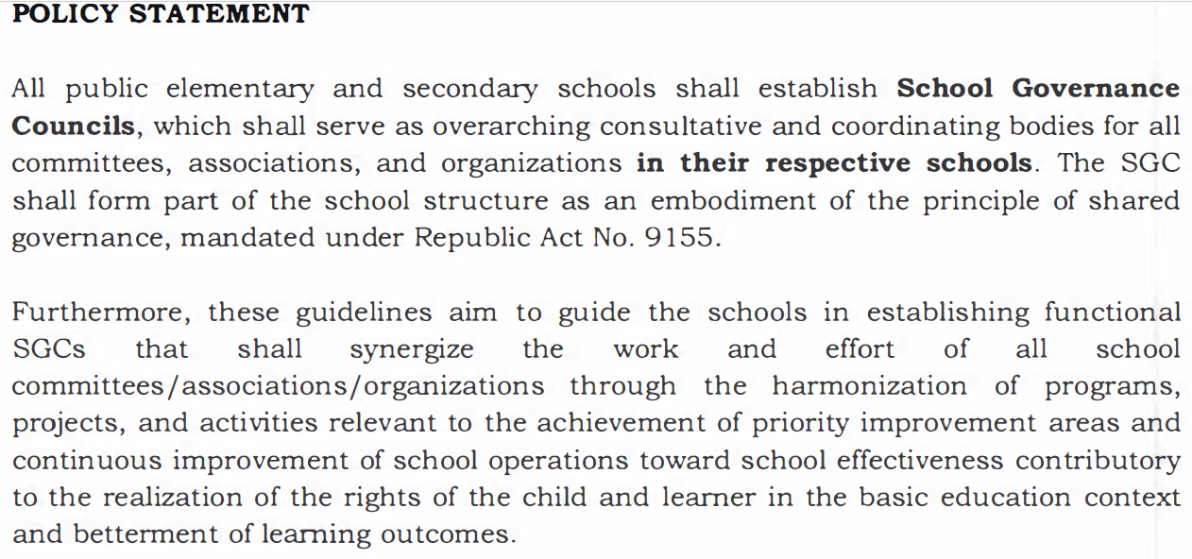

Slide 20
General Purpose of the School Governance Council
The SGC shall function as a structure for shared governance and a feedback mechanism at the school level. However, the SGC shall not manage the school and shall not have a separate and distinct juridical personality apart from the school.
The SGC shall not replace the Parents Teacher Association (PTA), Supreme Pupil/Student Government, School Planning Team (SPT), Alumni Association, Child Protection Committee (CPC), and other existing school committees/associations/organizations, but shall strengthen the school by synergizing the work of PTA, Supreme Pupil/Student Government, SPT, and Alumni Association, CPC with the efforts of other committees/associations/organizations in the school through shared governance, shared commitment, and shared accountability.

Slide 21
General Purpose of the School Governance Council
As a structure for shared governance, the SGC shall be an avenue where the democratic process of consultation with the school's internal and external stakeholders in the decision-making will be observed.
As a feedback mechanism, the SGC shall be a feedback link between the school stakeholders (learners, parents, and other school stakeholders) and school management (school head and personnel) on school performance and service quality.
The SGC provides a venue for parents, learners, teaching and non-teaching personnel, internal and external stakeholders, and the school head to work together towards continuously improving learning outcomes and ensuring that children's rights are respected, protected, fulfilled, and promoted in a gender-responsive, non­discriminatory, and inclusive physical and social learning environment.
two major purposes: structure for shared governance and feedback mechanism.

Slide 22
Committees and Coordinatorships
Designation through a Memorandum and Terms of Reference which contains the duties and functions connected to the designation
Action Plan
Quarterly Accomplishment Report
Accomplishment Report

Slide 23
Coordinatorship
ICT Coordinator
DRRM Coordinator
LR Coordinator
LIS/BEIS Coordinator

Slide 24
School Committees
School Personnel Selection Board
Bids and Awards Committees
School Quality Assurance Team

Slide 25
Reminders
Renew composition every year
Designation must be memorandized together with the TOR of each
Child Protection Committee to be included in the Student handbook
Sugge

Slide 26
How do we document involvement of stakeholders?
File Memorandum (Designation) together with their TORs
Action Plan with Accomplishment
Minutes of conducted Meetings

